Slide 1
Project: Solo Processing operating system
Operating system

Slide 2
Group Members
Ibrahim Qasim (42896)
Muhammad Aanis Ishaq (51712)
Ahmad Hassan Shahzad (42908)

Slide 3
Introduction
This Java application provide the basic operations of operating system
Including
Process creating
PCB

Slide 4
Key Features
Process management
Scheduling
Memory management
Io management
Synchronization

Slide 5
Process Management
the process management include
Process Creation
Process Deletion
Process Dispatch
Process Block

Slide 6
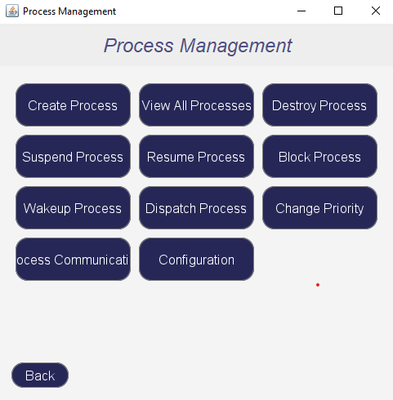
Process Management Output

Slide 7
Scheduling Algorithm
First Come First Served
Round Robin

Slide 8
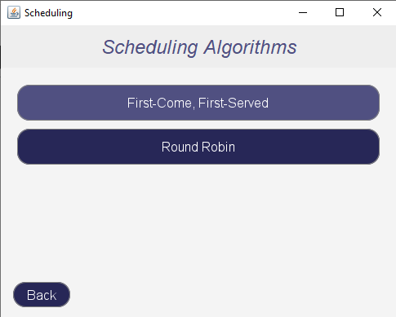
Algorithm output

Slide 9
Memory Management
The memory management include algorithm like
Paging
LRU ( Least Recently Used )

Slide 10
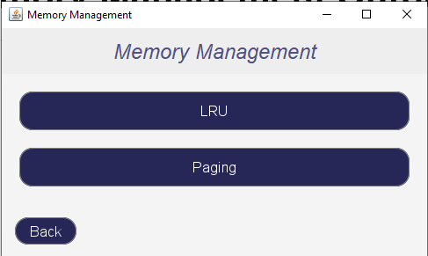
Memory Management Output

Slide 11
Process Synchronization
The process synchronization include two important methods
Semaphores Operation
Process Communication

Slide 12
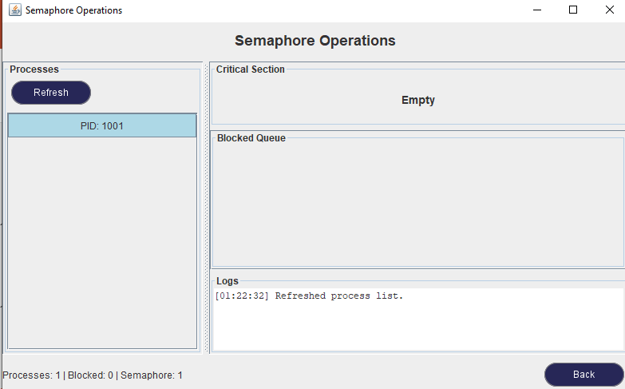
Semaphores Operations

Slide 13
Conclusion
This project demonstrates:
The basic operation of operating system

